Slide 1
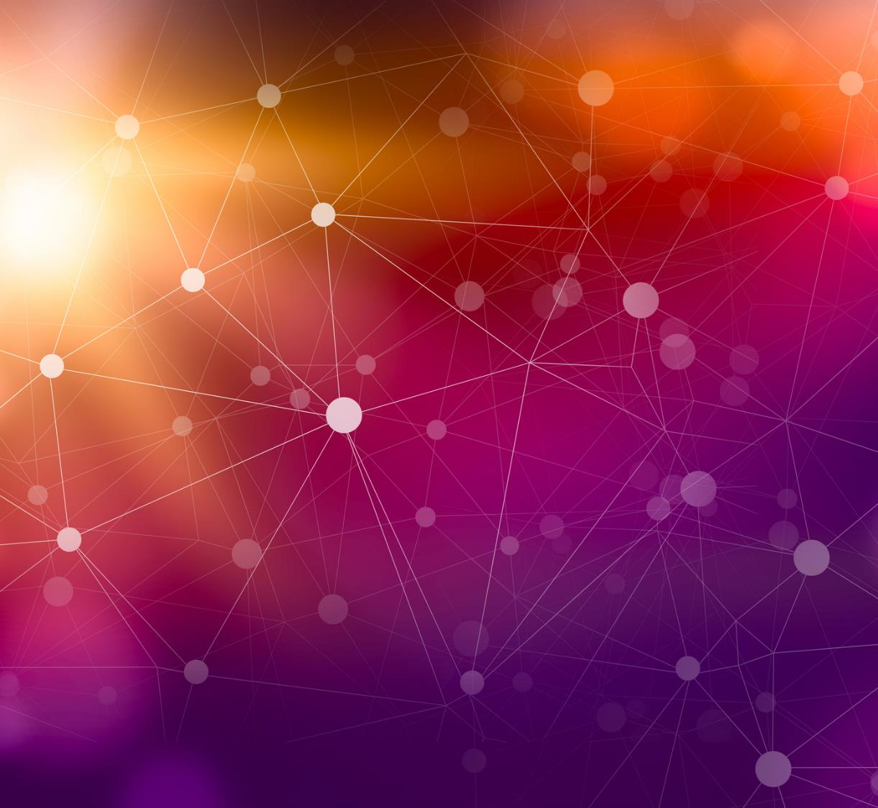
TENSOR IOT HACKATON
Team:
Abdul Fadel
Andres Jose
Baopeng Cai

Slide 2
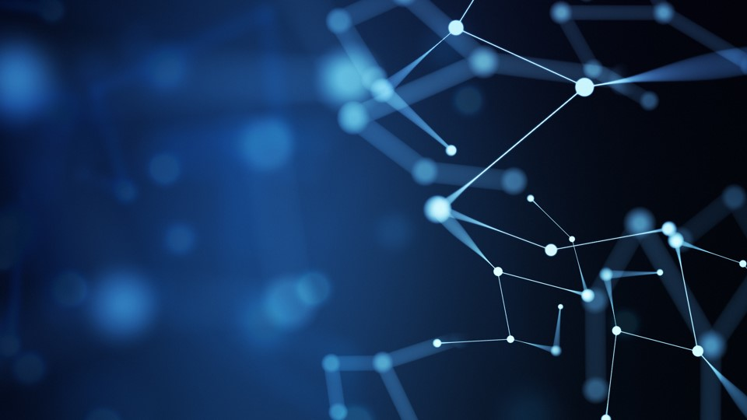
Features:
AI Chatbot embedded in Home Page
It will allow users to ask questions and navigate the site in a faster and comprehensive way. The learning curve of the site for new users will be non-existent with the help of the AI chatbot.
Login with Authentication for Users
Users will that Sign Up will have an enhanced experience by combining the AI chatbot with their personal information. This could be applied to taxes, targeted notifications, remainder's and more. Some if this features are not implemented but will be in the future.

Slide 3
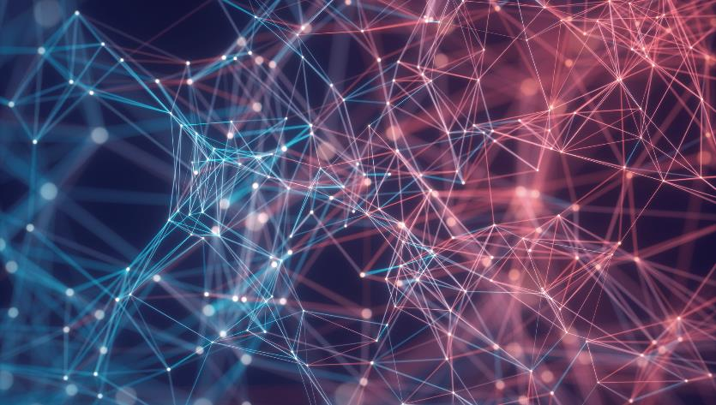
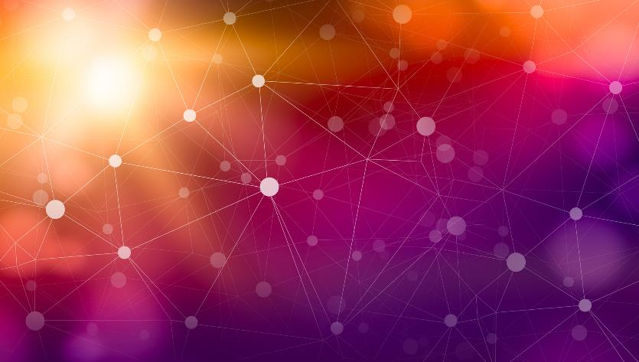
Future Features
Embed AI Chatbot application using Flask
Fully Implement User Authentication with Google Firebase
Implement Taxes portal with Payments
Implement Web 3.0 Features

Slide 4
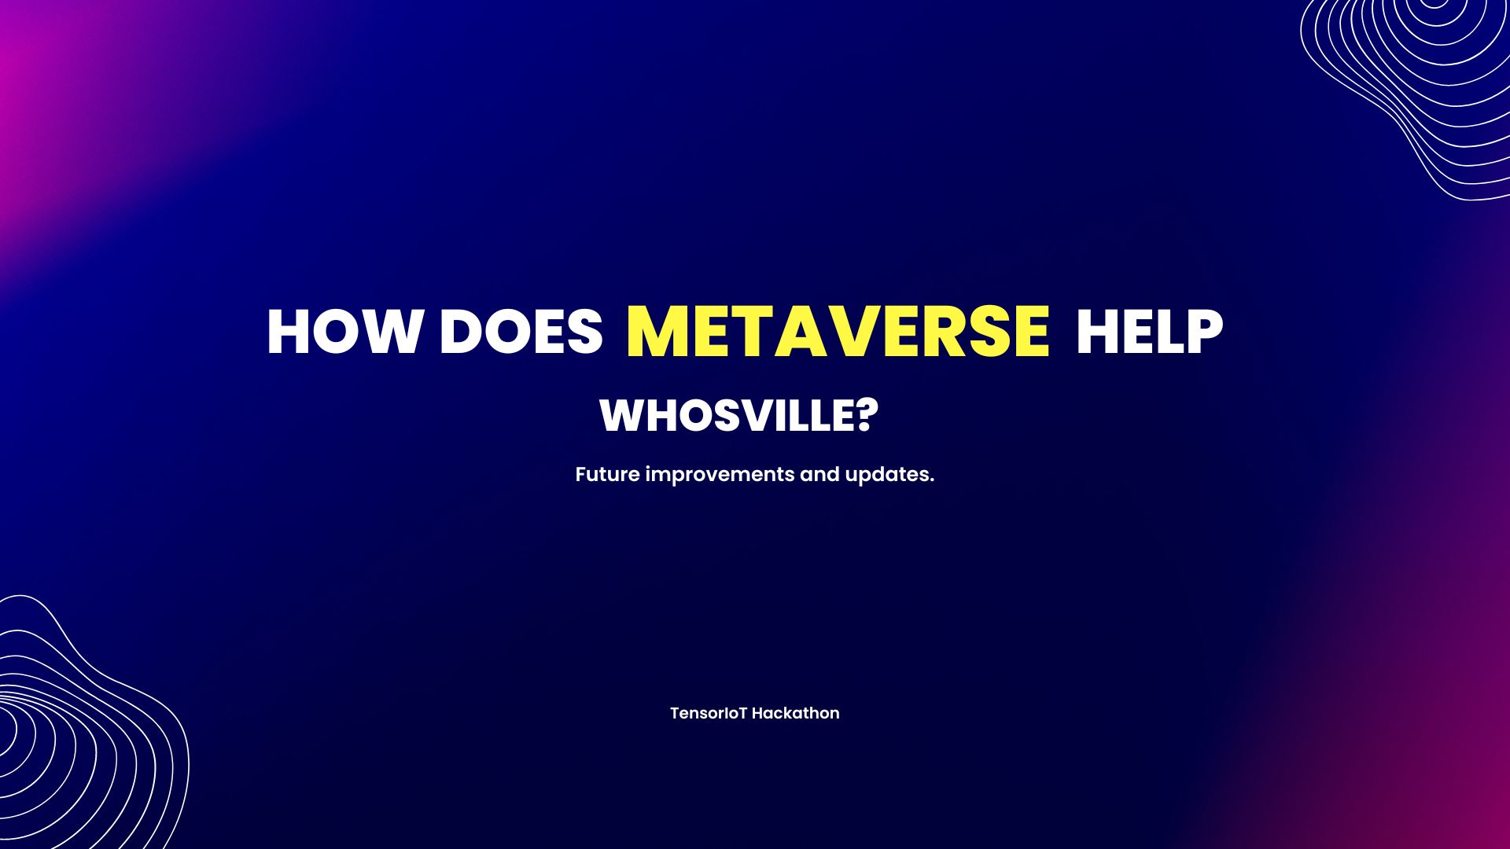

Slide 5
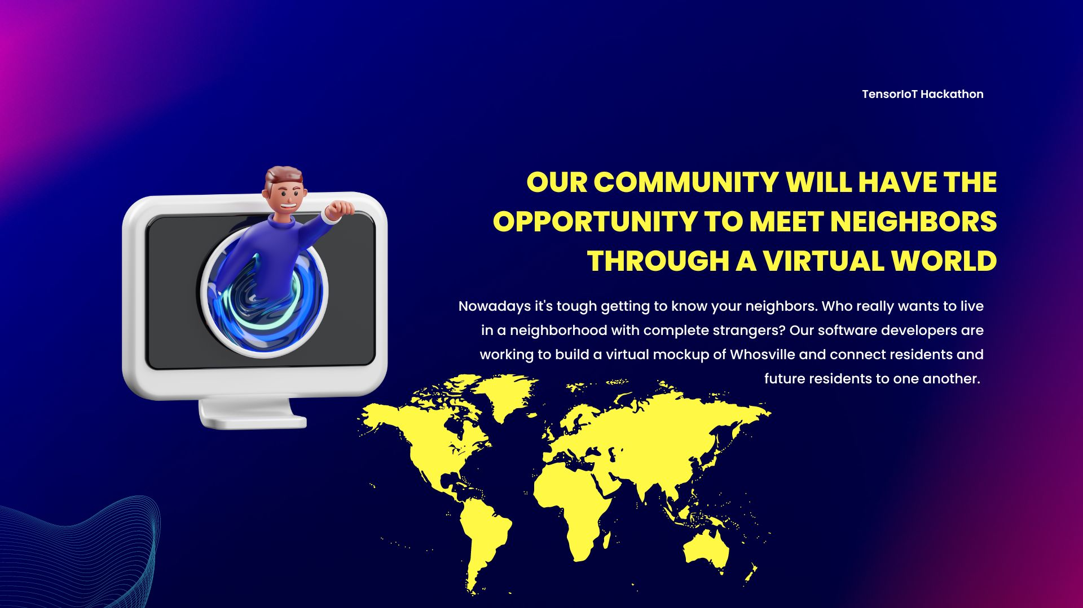

Slide 6
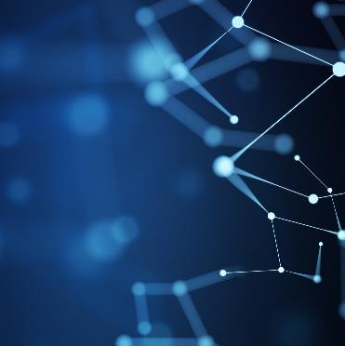
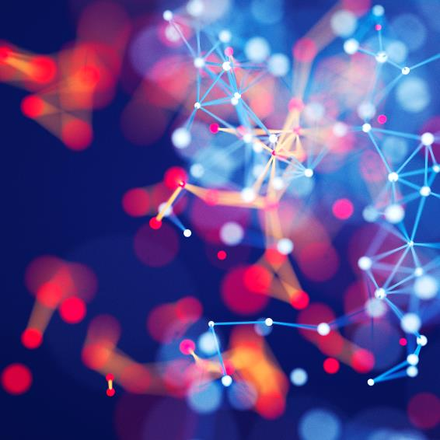
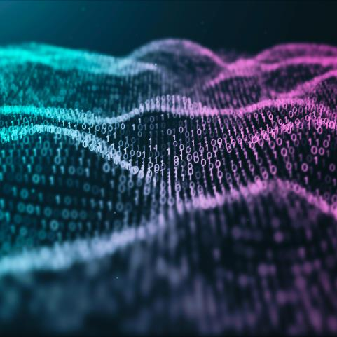
Technologies Used
Javascript
Phyton
API’s
HTML
CSS
Bootstrap

Slide 7
Thank You! Abdul Fadel | Andres Jose | Baopeng Cai

